Slide 1
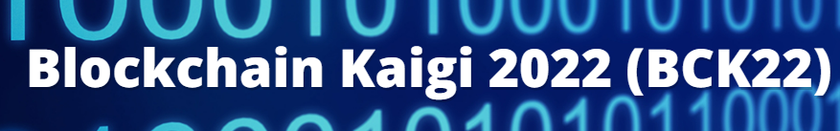
Acquiring Semantic Mode Signal from Tweets of #Crypto Currencies
- A trial of detecting semantic direction from high dimensional word vector space with sparsity -
Aug. 5. 2022
Hiroshi Uehara¹, Wataru Souma¹, Yuichi Ikeda²
1 Rissho University, 2 Kyoto University

Slide 2
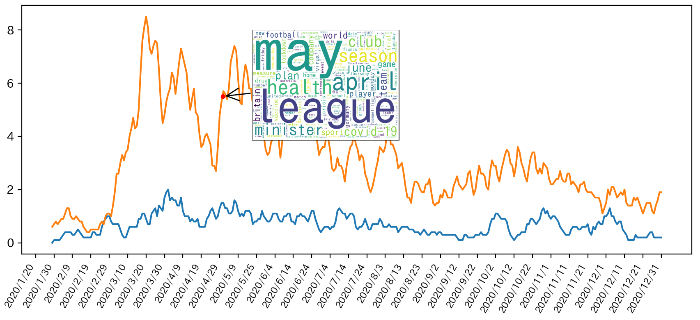
Tweets : popular data for understanding trends
Just counting the number of tweets in each time slice
Bigger words represent people’s concerns
Notes:
Twitter or other sns become very popular data for understanding trends people concern.
Just counting up words in the numerous tweets by each time slice
enable to visualize the trends. Bigger words represent stronger concerns.

Slide 3
Big words are not necessarily represent semantic coherence
Figure 2
Figure 1
Big and scattered concerns
Big and semantic coherence
➡ Semantic Collective
motion(herding)
Covid-19
Lock down
economy
Olympic game
Vaccine
ECMO
Medical collapse
State of emergency
Covid-19
Latent market movements
Notes:
However, these big words are not necessarily semantically coherent.
For example on figure 1, all the big words represent the topic of covid 19
But, the words do not have any semantic connection with each other, rather represent scattered concerns.
Meanwhile, the big words in Figure 2 represent some semantic coherence concerning medical crisis.
sometimes we would like to know the emergence of this kind of semantic coherence,
because the coherence implies latent energy toward one direction, for example
in the markets movements.
So we call this states of coherence a collective motion.

Slide 4
Semantic mode signal :
A method to acquire semantic collective motions from extremely high dimensional vector space
Time slice
1st Eigenvalue
Word cloud
0:00-0:01
0.45
vaccine
Coherent semantics
Pfizer
Doctors
Degree of collective motions
Weighted words = Semantic collective motions
0:00-0:02
0.11
Doctors
Doctors
Notes:
The semantic collective motions are represented by word cloud.
Where, larger fonts represents strong semantic collective motions at each time slice
and these big words represent coherent semantics.
Meanwhile, 1st eigenvalue in each time slice represents the degree of collective motions.
So, we call this semantic collective motions together with 1st eigenvalue semantic mode signal.
In summery, semantic mode signal is proposed aiming to detect semantic collective motions from very high
dimensional sparse vector space.

Slide 5
Data
Price data and tweets of 19 crypto currencies as of 2022.Feb.24(outbreak of Ukraine conflict)
19 Crypto currencies :
EOS, Polkadot, Bitcoin, Chainlink, Filecoin, Ethereum, Dogecoin, USD Coin, Cardano, XRP, Ethereum, Aave, Stellar, Algorand, Tether, The Graph, Uniswap,Litecoin,
Price data
: one-minute price gap(open to close) of the 19 currencies
Tweets data : tweets of the 19 currencies (approx. 30,000)
Notes:
For empirical examination, both of price data and corresponding tweets for 19 crypto currencies are
prepared. The date is feb 24
Price data are partitioned by one-minute,
Meanwhile , we applied topic model to tweets amounting to approx.30000

Slide 6
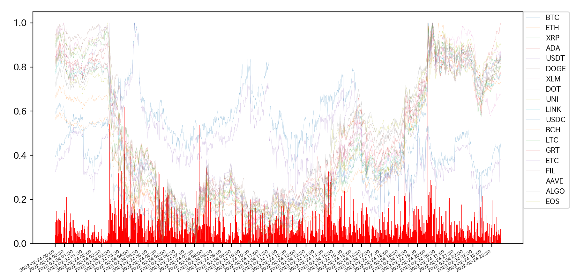
Conventional mode signal based on 19 crypto price data
Mode signal captures the changing point of trends
USDC
USDT
Crash!
Surge
Other cryptos
Downward
Upward
Mode signal
bouncing
Notes:
The red bars indicates conventional modesignal acquired from the price data overlapped by price fluctuations scaled to 0 to 1.
Several peaks appear indicating collective motions. The peaks are located at changing point from downward
trend to upward and vice versa.

Slide 7
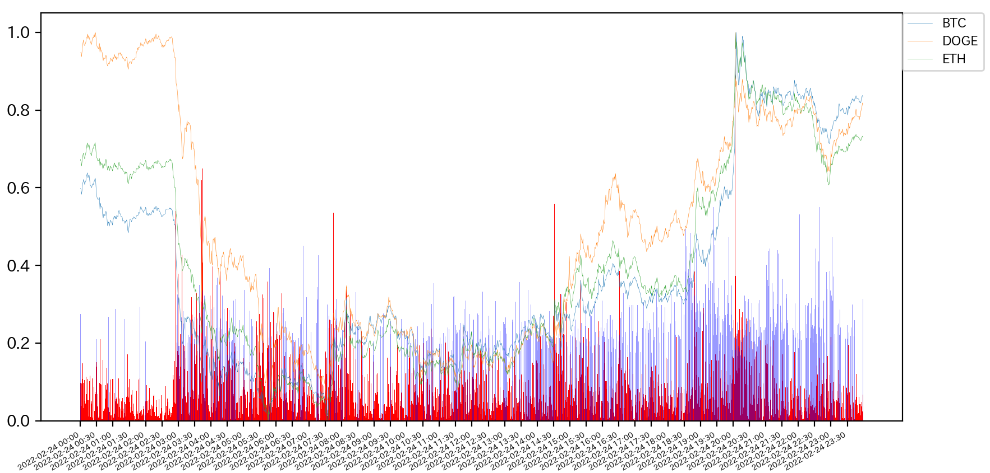
Semantic mode signal from # crypto tweets
Peaks of semantic mode signal are populated around the peaks of conventional mode signal
Level of collective motions are coincident between blue and red bars
Semantic mode signal
Mode signal
Notes:
And here, semantic modesignal from tweets is illustrated as blue bars ,
In general the peaks of blue bars populate around that of red ones.
Which indicates collective motions are coincident with each other.

Slide 8
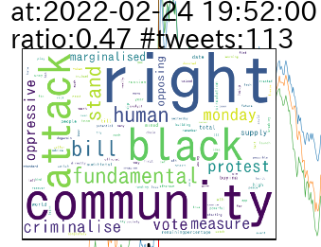
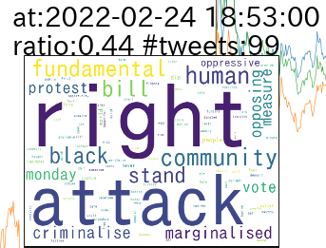
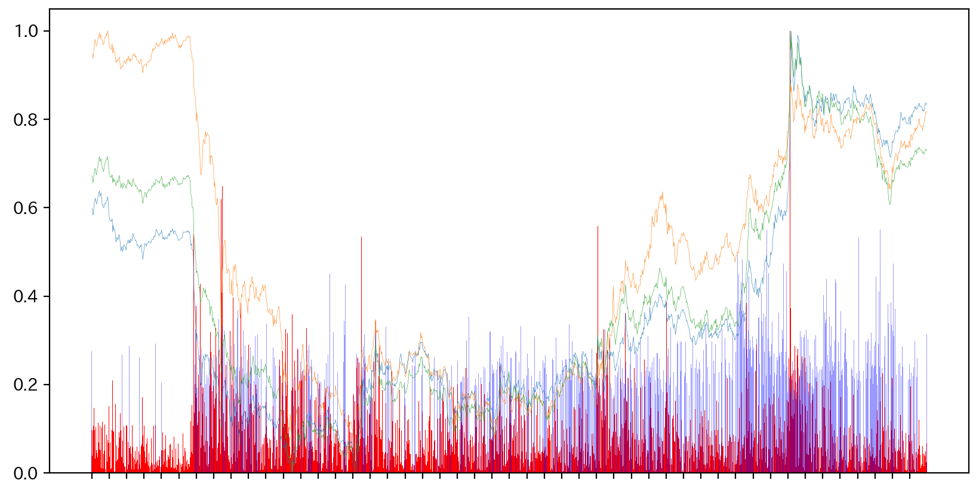
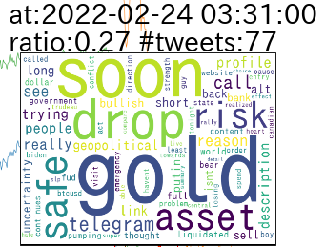
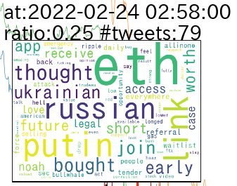
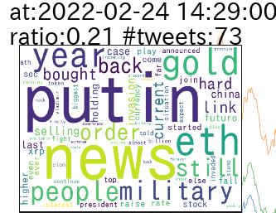
Semantic collective motion
News : 3:46, February 23, 2022
Putin calls for the "demilitarization" of Ukraine after announcing military action in Donbas
News: 18:26, February 24, 2022
Hundreds of people detained in anti-war protests around Russia,
Notes:
This shows the semantics collective motions. We prepared interactive UI that the semantics appear as the word
cloud by clicking the bars.
At 2:58 on feb 24, the semantics shows the word, Russian, putin Ukraine which are coincident with
the start of invasion. And then at 3:31, semantics are symbolized by gold asset, safe, risk implying negative
sentiment and investing actions toward safe assets.
At 14:29 again putin military appears but this time they appear during uptrend of the prices.
At 18:53, the words, human right, criminalize and protest, stand attack appear implying
Defending human rights and fight against criminalized attack. In fact the community means
The momentum of crypto community donate to Ukraine.
As such, the big words in each word cloud have semantic coherence, and
former half of the collective motions imply negative sentiment and the latter half shows
completely reversed positive sentiment against the same incident.

Slide 9
Conclusion
The proposal ‘Semantic mode signal’ properly captured collective motions from extremely high dimensional vector space of tweets in terms of
The peaks coincide with the one of conventional mode signal.
Semantic mode signal provided coherent semantics for the peaks of mode signal
Notes:
.

